Slide 1
A Guide to Writing a Teachers Institute of Philadelphia Curriculum Unit
Alima McKnight, Richmond School

Slide 2
Step 1: Start Thinking!
Revisit your proposed ideas for your unit. It is still very early in the seminar, so you may change your mind, but it is a good place to start. Remind yourself of what you thought you could do with the unit. You may find that your idea will be expanded by the information you get in the seminar, but that the heart of what you want to do is the same. If that's the case, you can begin crafting your narrative. If you think you are starting to change your mind, focus on the reason you wanted to take the seminar and still begin the narrative!

Slide 3
Step 2: The Research
Included in your narrative should be research that supports your choices for your overall unit and specific lessons. Advice: start with the resources your seminar leader has provided and go from there. Preview all the readings and articles, videos and slides. See if there is a title, fact, or statistic that stands out and gets you excited. If there is, then that may be the road on which to start.

Slide 4
Step 2: The Research
Start to build a cache of information for your narrative. I start with a few articles that interest me by title and abstract. Then I scan to see what I can learn for my unit. If nothing pops out, I go to the bibliography and read the titles there-- maybe what I am really looking for came before the article I am currently reading & I need to go backwards a little by checking our their sources.
Advice: create a folder on your computer to hold your articles and links. Create it, name it, and load it up. It’s always better to have too much and not need it, than need it and not have it. And it’s best to set this all up ASAP!

Slide 5
Step 2: The Research
For those who are like me and choose the method of engagement (ie. using self regulation, creating media) prior to the start of the seminar, previewing the content will help you narrow your focus for what info you want to convey to students via the method you have chosen. Also remember that your research should support why you chose that specific way to engage your students.
Unit:
Using infographics
Researched:
How visuals enhance learning, esp for SpEd and ELL students
Unit:
Using weaving & teepee design
Researched:
How hands on learning solidified connections to content
Unit:
Using games
Researched:
How gamification theory can apply to elementary kids

Slide 6
Step 3: The Narrative
The narrative is why you wanted to take this seminar, what you got out of it, and how that information will benefit your students. It comprises
The Unit Content (a clear statement of the subject matter the unit seeks to cover)
The Teaching Strategies (a coherent plan for teaching that content)
For some, it tells the story of the socioeconomics of your students and how they need the information or would use the information you learned.
For some, it tells the story of the special needs of your students and how this information benefits their academic or personal lives.

Slide 7
Step 3: The Narrative
For me the narrative was always about engagement and using the topic of the seminar and a research based approach to teach it to my students. I have also made sure to think about my SpEd and ELL students.
Seminar:
Data Visualization
Question:
How do I engage students in data collection in the elementary classroom?
Unit:
Using infographics to teach ELA topics, like character traits and immigration.
Seminar:
Native American Art
Question:
How do I engage students using Native American art?
Unit:
Using weaving and teepee design to teach about Native American culture.
Seminar:
Sustainable Philadelphia
Question:
How do I engage students when learning about climate change and sustainability?
Unit:
Use gamification to create a game for them to learn from and teach them how to create their own game to spread awareness and information.

Slide 8
Step 3: The Narrative
The style and voice of your narrative depends on you, as long as you have a way for the reader to connect to your situation. The goal is for another teacher to feel like they know why you chose to create the unit and that they could use your unit in their own classroom.
The Narrative Sentence Starter Examples
Personal
Expository
Researcher
I teach...
This seminar...
I wanted to...
My students will...
Philadelphia...
The seminar...
The students will...
The students...
One topic...
This field of study...
Students in this ...

Slide 9
Step 3: The Narrative
Teaching strategies − a coherent plan for teaching the unit content, including evaluative tools
Teaching strategies vary depending on grade level, engagement strategies, and preferred teaching styles. Choose either what you like or research something you have always wanted to try and include an argument in support of your choice in your paper.

Slide 10
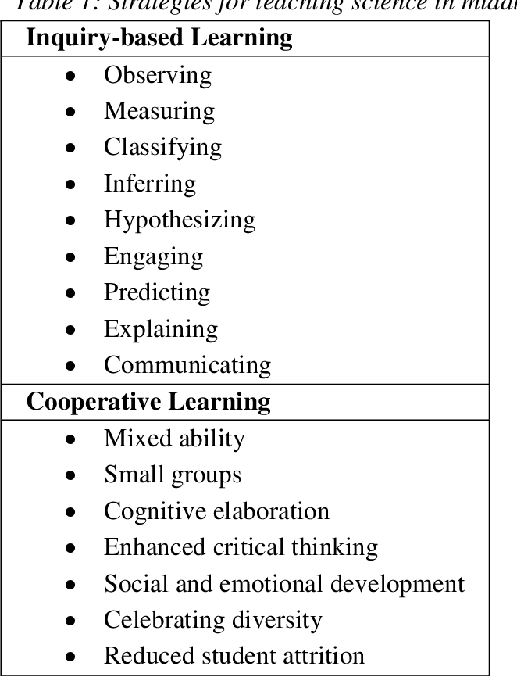
Step 3: Narrative
Teaching strategies: examples; describe in detail in your unit

Slide 11
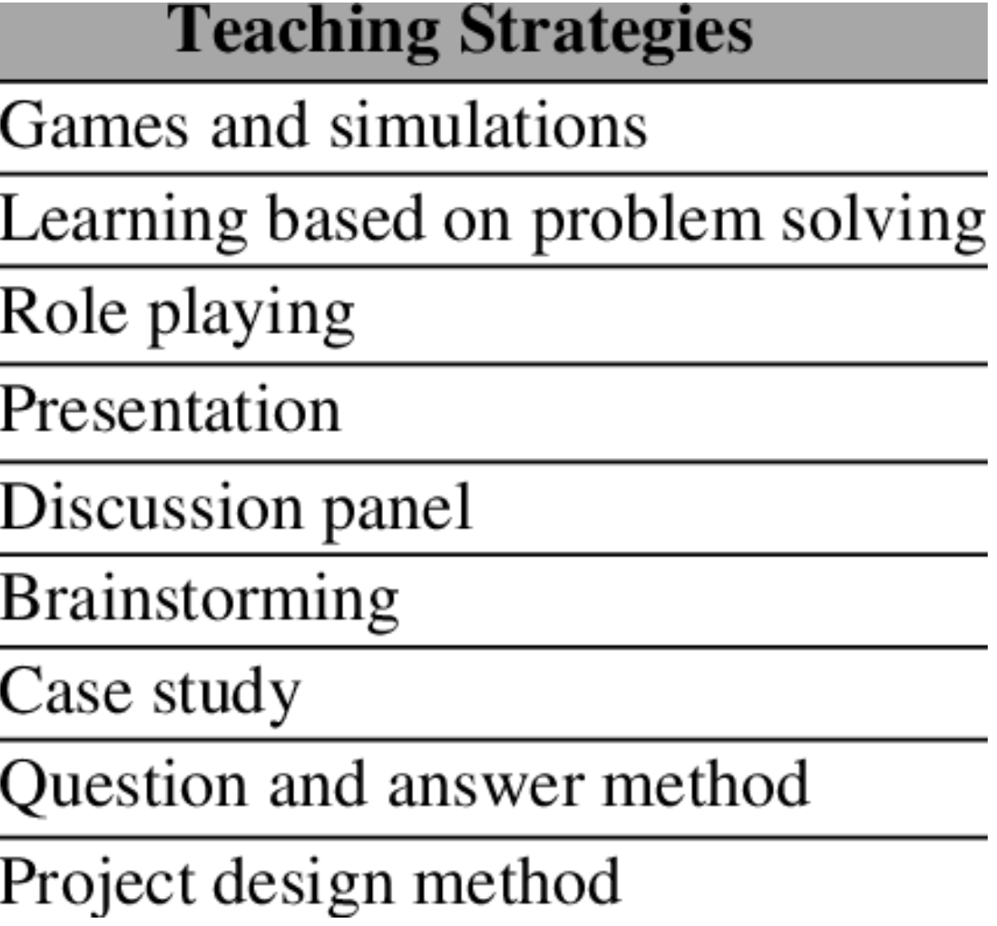
Step 3: Narrative
Teaching strategies: examples; describe in detail in your unit

Slide 12
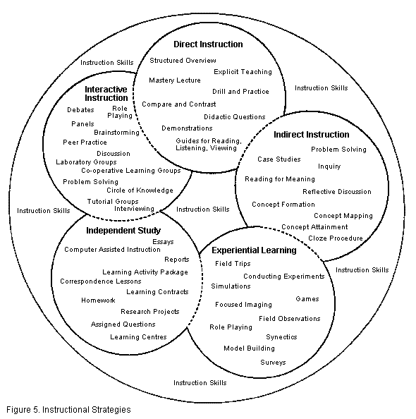
Step 3: Narrative
Teaching strategies: examples; describe in detail in your unit

Slide 13
Step 4: Remaining Elements of the Curriculum Unit
Now that you have previewed the seminar content and found additional resources to build a compelling narrative “that explains, in clear, concise and accessible language the new information a fellow has acquired from the seminar,” it’s time to start thinking about how you are going to teach this information to students and present that plan to teachers:
Classroom activities
Resources
Appendix
Abstract

Slide 14
Step 4: Remaining Elements of the Curriculum Unit
1. Classroom activities − three or more detailed examples of actual teaching methods or lesson plans
This is where the lessons go. You can write them out in paragraph form as a step by step or you can create lesson plans. As an elementary school teacher, I opt for lesson plans. I’m used to it and TIP doesn’t require any particular format, so you can choose what you think will make using your plans best for another teacher.

Slide 15
Step 4: Remaining Elements of the Curriculum Unit
1. Classroom activities − three or more detailed examples of actual teaching methods or lesson plans
In my units, I have used several different formats over the years. The formats have been tied to SDP guidelines, the kind I did in college, and formats that I thought would help teachers with the sometimes technical or complex nature of the lessons I created.

Slide 16
Step 4: Remaining Elements of the Curriculum Unit
2. Resources − Lists of source materials for the unit: works cited in the unit content section; an annotated list of classroom resources for teachers and students.
This is an annotated bibliography, for both where you got your information and for what resources you suggest should be shared with students. This will help a teacher using your unit who wants to dive a little deeper into your researched material or have a better understanding of why you chose a given resource for students.

Slide 17
Step 4: Remaining Elements of the Curriculum Unit
3. Appendix – a list of district, state and national academic standards covered in the unit, along with any supplemental materials used in the unit.
The appendix should list the standards addressed. It should also have any worksheets you made or know is copyright free to use.

Slide 18
Step 4: Remaining Elements of the Curriculum Unit
4. Abstract: a summary (no more than 200 words) of the unit content and goals.
Google “abstract examples” if you are not familiar with writing one. Find a style you like and taylor it to your unit. Advice: let this be one of the first things you actually write (you can always change it later, but an abstract “forces” you to get to the heart of your unit). Expound upon it for this part of the paper, but start with fundamental purpose and most defining part of your content matter and message.

Slide 19
Speaking of Copyright…
Your curriculum unit will be published on Penn’s site. There can be no copyright issues!!! If you find a copyrighted resource you really just have to use, contact the owner right away to ask permission to use it. If you get permission, you must tell that. One way to avoid copyright infringement is to give links. The articles in the research part of your unit will be cited as per APA or MPA style, but other material like worksheets or images would be easiest to just link. For me, I just make my own worksheets to include. Penn has a form letter for contacting copyright owners on the TIP Resources page.

