Slide 1
An Introduction to Integration

Slide 2
Estimation of area using rectangular approximation of area
Distance calculations as the area under a curve
What you’ll learn . . .
. . . why?
Learning about estimating with finite sums lays the foundation for understanding integral calculus.

Slide 3
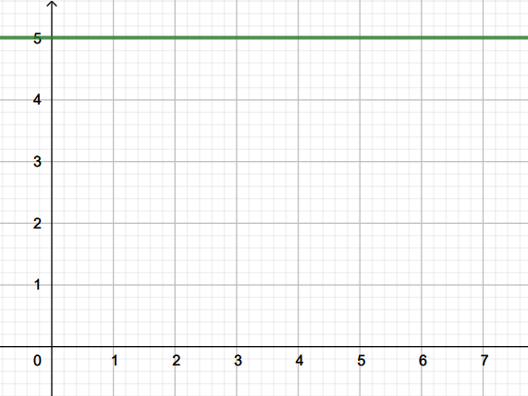
Estimating Area The Old-Fashioned Way
Geometry Method
Area
Length x width
Width = 4 units
Length = 5 units
Area = 4 x 5 = 20 units²
Width = 4 units

Slide 4
Finding Reimann Sums
Estimation of area using rectangular approximation
Function is a constant

Slide 5
Reimann Sums Estimation of area using rectangular approximation Function is a constant
a b
Example: The distance traveled in 4 hours by a tow boat traveling 5 miles per hour

Slide 6
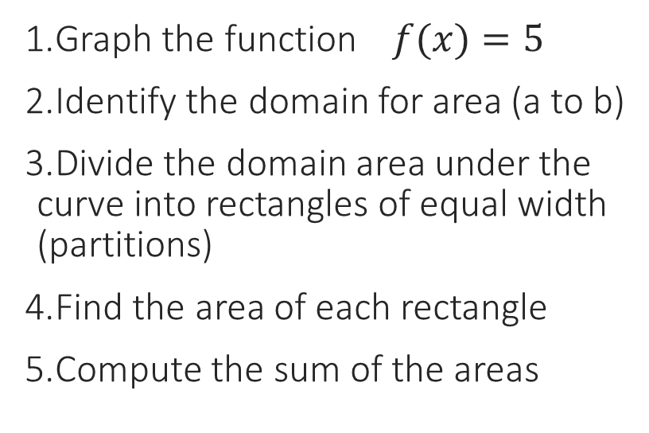
Reimann Sums Estimation of area using rectangular approximation Function is a constant
Instructions
Graph the function $f(x)=5$
Identify the domain for area (a to b)
Divide the domain area under the curve into rectangles of equal width (partitions)
Find the area of each rectangle
Compute the sum of the areas
a b
Function constant over time

Slide 7
Reimann Sums Estimation of area using rectangular approximation Function is a constant
Graph the function
Divide the domain area under the curve into rectangles of equal width (partitions)
❶
❷
❸
❹
a b
Identify the domain for area (a to b)
a = 2; b= 6

Slide 8
Reimann Sums Estimation of area using rectangular approximation Function is a constant
Calculations:
Find the area of each rectangle
Area = Width * Height
Width = 1 Height = 5
Area = 1 * 5 = 5
Compute the sum of the areas
Area 1+ Area 2+ Area 3+ Area 4
= 5 + 5 + 5 + 5 = 20 sq units
❶
❷
❸
❹
a b
a b

Slide 9
Finding Reimann Sums
Function varies over time
Estimation of area using rectangular approximation

Slide 10
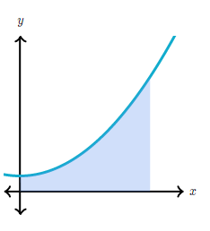
How can we find
the area under
the graph of this
function?

Slide 11
Start with something that we know . . .

Slide 12
We know how to find the area of a triangle
Area = ½ base * height

Slide 13
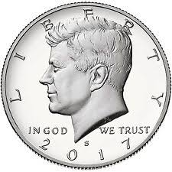
We’ll start by filling a triangle with coins, one column at a time

Slide 14
What do you notice?

Slide 15
Do all the coins fit in the triangle?

Slide 16
Are there any uncovered spaces?

Slide 17
How many coins? (height) How many columns?
(width)

Slide 18
What is the area of the triangle?

Slide 19
What if we use another coin?

Slide 20
What is the area of the triangle?

Slide 21
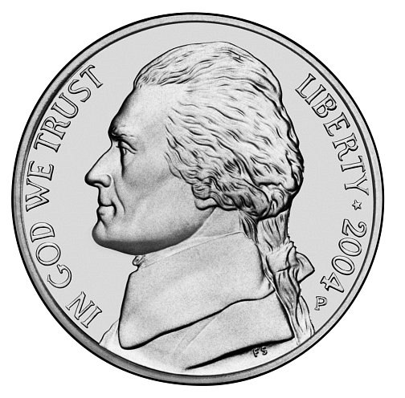
What if we use another coin?

Slide 22
What is the area of the triangle?

Slide 23
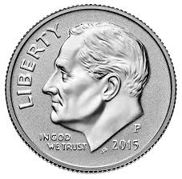
What if we use another coin?

Slide 24
What is the area of the triangle?

Slide 25
Find the area of a function that varies over a time interval

Slide 26
Reimann Sums Estimation of area using rectangular approximation Function varies over time
Instructions
Graph the function
Identify the domain for area (a to b)
Divide the domain area under the curve into rectangles of equal width (partitions)
Find the area of each rectangle
Compute the sum of the areas
a b
Function varies over time

Slide 27
Reimann Sums Estimation of area using rectangular approximation Function varies over time
Graph the function
a b
2. Identify the domain for area (a to b)

Slide 28
Reimann Sums Estimation of area using rectangular approximation Function varies over time
3. Divide the domain area under the curve into rectangles of equal width (partitions)
4. Find the area of each rectangle
5. Compute the sum of the areas

Slide 29
Reimann Sums Estimation of area using rectangular approximation Function varies over time
Divide the partitions into smaller sizes for a better estimate

Slide 30
Reimann Sums Estimation of area using rectangular approximation Function varies over time
Divide the partitions into even smaller sizes for a better estimate of area

Slide 31
Reimann Sums Estimation of area using rectangular approximation Function varies over time
Divide the partitions into even smaller sizes for a better estimate

