Slide 1
The Problem

Slide 2
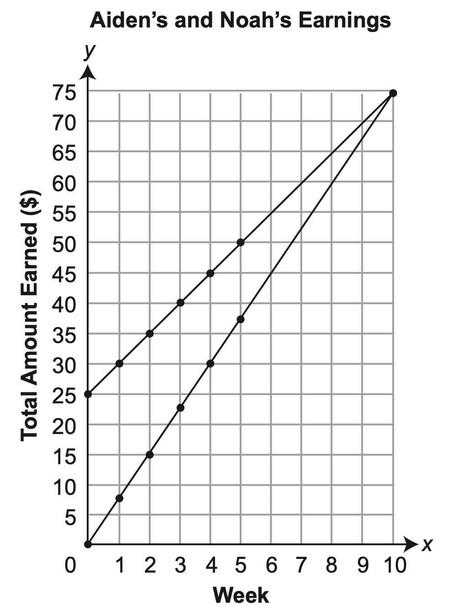
Aiden and Noah are going to work for their neighbor this summer. The neighbor gives Aiden $25 at the beginning of the summer and then pays him $5 each week to mow the lawn. The neighbor pays Noah $7.50 each week to walk the dog. The graph shown below models the total amount of money (y) each boy has earned after working for x weeks. What does the point of intersection on the graph represent?

Slide 3
Aiden and Noah are going to work for their neighbor this summer.

Slide 4
Aiden and Noah are going to work for their neighbor this summer.
Aiden
Noah
Dog

Slide 5
Aiden and Noah are going to work for their neighbor this summer. The neighbor gives Aiden $25 at the beginning of the summer and then pays him $5 each week to mow the lawn. The neighbor pays Noah $7.50 each week to walk the dog. The graph shown below models the total amount of money (y) each boy has earned after working for x weeks. What does the point of intersection on the graph represent?

Slide 6
The neighbor gives Aiden $25 at the beginning of the summer and then pays him $5 each week to mow the lawn.

Slide 7
The neighbor gives Aiden $25 at the beginning of the
summer….
$$$$$$$$$$
$$$$$$$$$$
$$$$$

Slide 8
The neighbor gives Aiden $25 at the beginning of the summer
and then pays him $5 each week to mow the lawn.
$$$$$$$$$$
$$$$$$$$$$
$$$$$
$25

Slide 9
The neighbor gives Aiden $25 at the beginning of the summer
and then pays him $5 each week to mow the lawn.
$$$$$
Week One

Slide 10
The neighbor gives Aiden $25 at the beginning of the summer
and then pays him $5 each week to mow the lawn.
$30
$$$$$
Week One

Slide 11
The neighbor gives Aiden $25 at the beginning of the summer
and then pays him $5 each week to mow the lawn.
$$$$$
Week Two

Slide 12
The neighbor gives Aiden $25 at the beginning of the summer
and then pays him $5 each week to mow the lawn.
$35
$$$$$
Week Two

Slide 13
The neighbor gives Aiden $25 at the beginning of the summer
and then pays him $5 each week to mow the lawn.
$$$$$
Week Three

Slide 14
The neighbor gives Aiden $25 at the beginning of the summer
and then pays him $5 each week to mow the lawn.
$?
$$$$$
Week Three

Slide 15
This continues.
$?
$$$$$
Lawn looks good Aiden!

Slide 16
Aiden and Noah are going to work for their neighbor this summer. The neighbor gives Aiden $25 at the beginning of the summer and then pays him $5 each week to mow the lawn. The neighbor pays Noah $7.50 each week to walk the dog. The graph shown below models the total amount of money (y) each boy has earned after working for x weeks. What does the point of intersection on the graph represent?

Slide 17
The neighbor pays Noah $7.50 each week to walk the dog.

Slide 18
The neighbor pays Noah $7.50 each week to walk the dog.
Noah
Dog

Slide 19
The neighbor pays Noah $7.50 each week to walk the dog.
Week One
$7.50

Slide 20
The neighbor pays Noah $7.50 each week to walk the dog.
Week One
$7.50

Slide 21
The neighbor pays Noah $7.50 each week to walk the dog.
Week Two
$7.50

Slide 22
The neighbor pays Noah $7.50 each week to walk the dog.

Slide 23
The neighbor pays Noah $7.50 each week to walk the dog.
Week Three
$7.50

Slide 24
This continues.
Dog is so happy Noah, thanks!

Slide 25
Aiden and Noah are going to work for their neighbor this summer. The neighbor gives Aiden $25 at the beginning of the summer and then pays him $5 each week to mow the lawn. The neighbor pays Noah $7.50 each week to walk the dog. The graph shown below models the total amount of money (y) each boy has earned after working for x weeks. What does the point of intersection on the graph represent?

Slide 26
The graph shown below models the total amount of money (y) each boy has earned after working for x weeks. What does the point of intersection on the graph represent?

Slide 27
The Problem (Multiple Choice Answers Included)

Slide 28
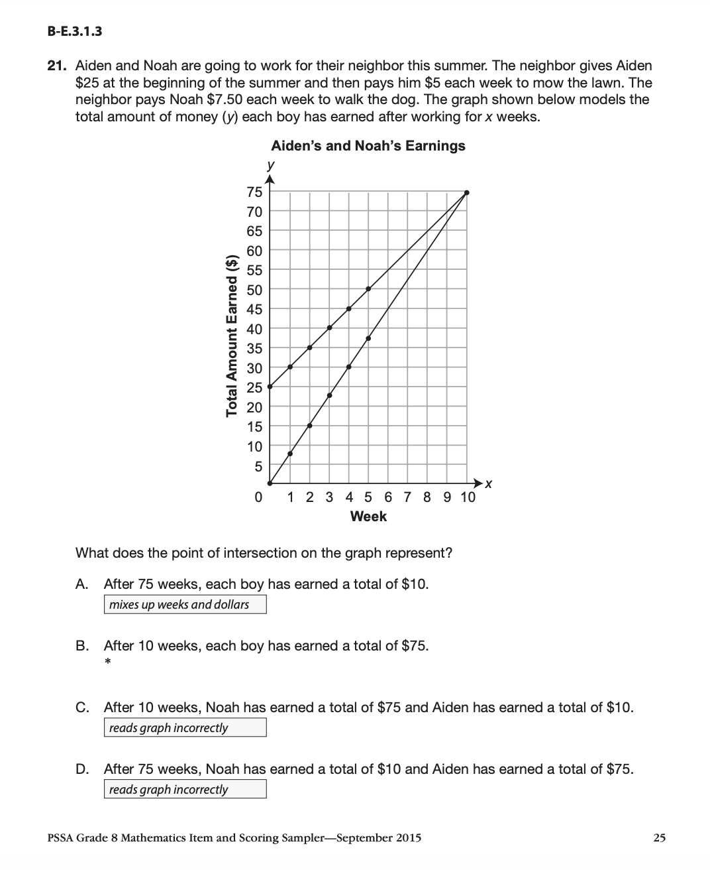
Remove Blue Rectangles to see correct answer.

